Slide 1


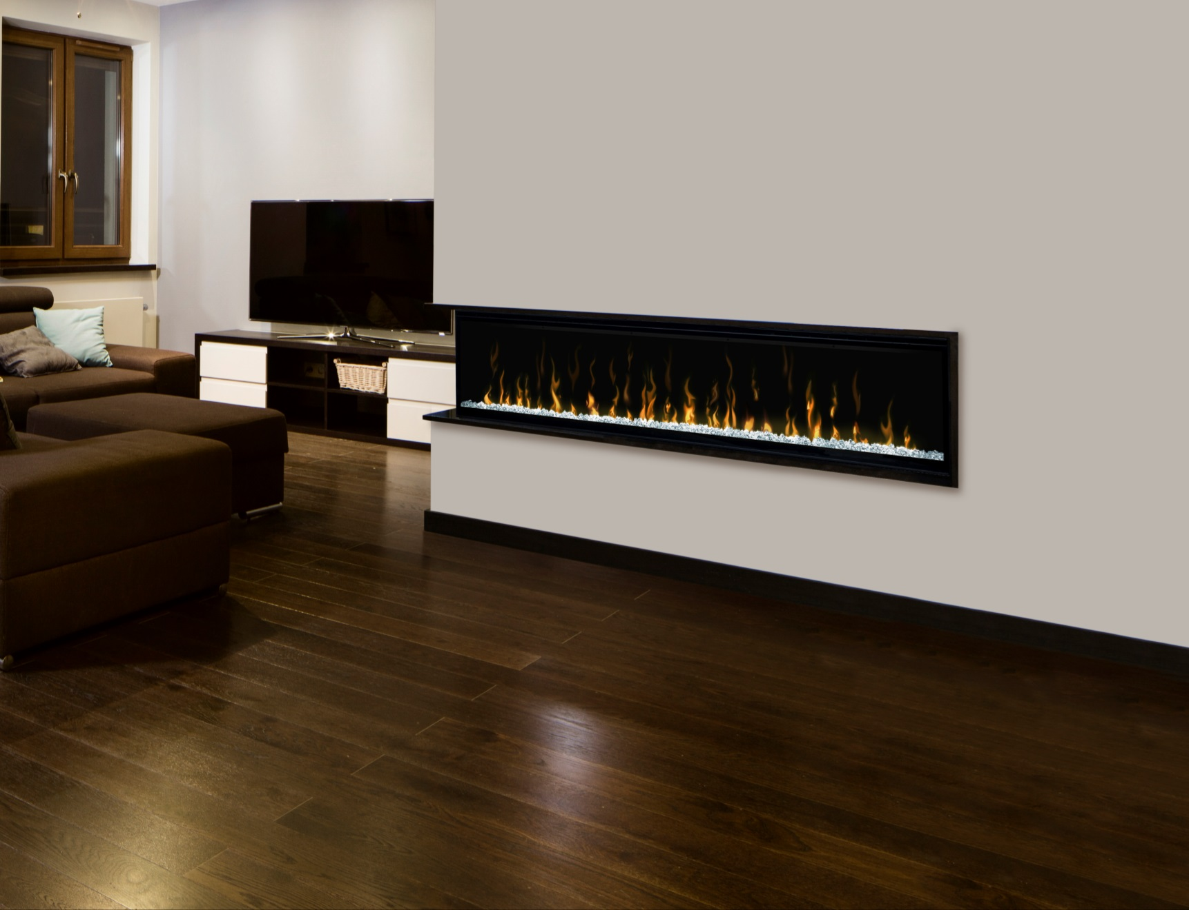
Linear Electric Fireplaces
Designed to Ignite your passion.

Slide 2

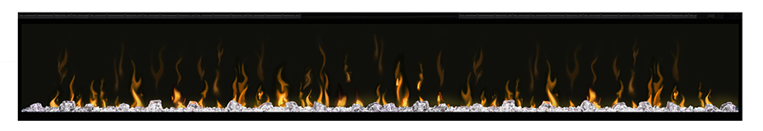
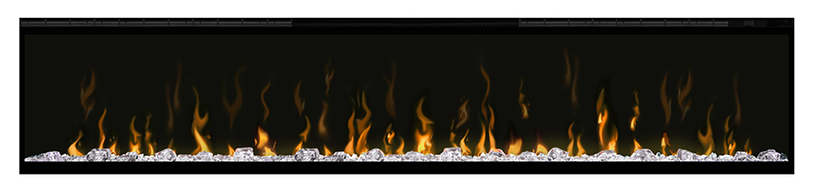
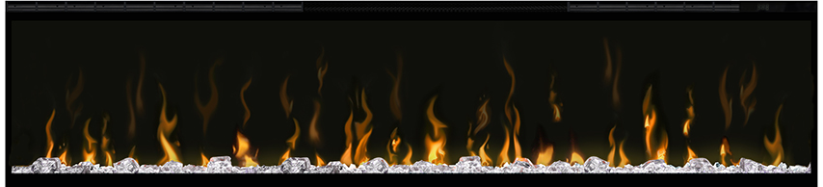
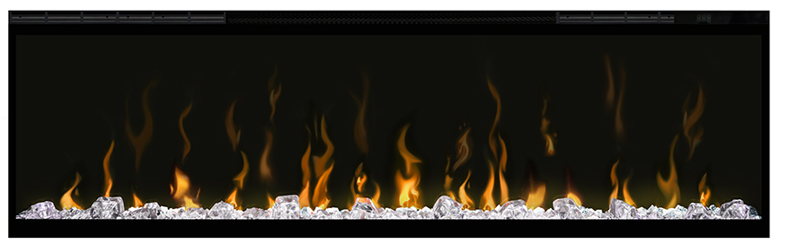
Linear Electric Fireplaces
XLF100
XLF74
Completely new design from the inside out with new flame and heat technology
XLF60
Series includes a 50,60, 74 and a stunning 100 inch model – the largest Dimplex Electric Fireplace
XLF50

Slide 3
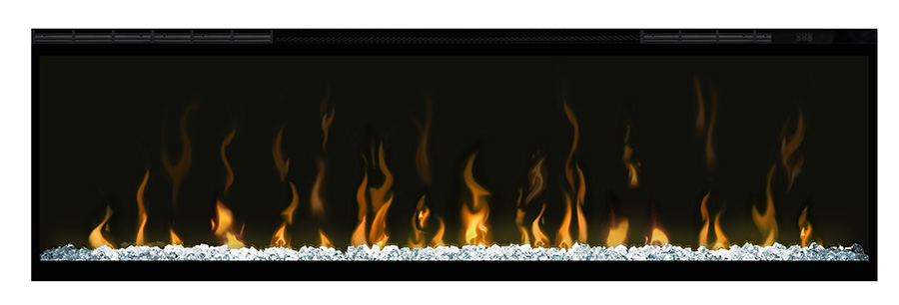
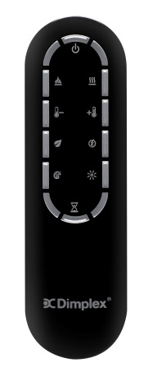
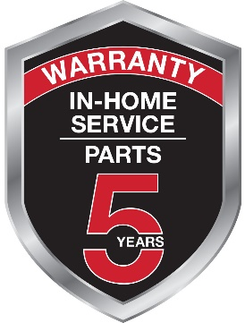
Key Features
Comfort$averTM Heating System
Supplemental heat for up to 1,000 sq. ft.
Capacitive touch controls
Clean-face, edge-to-edge glass design
Diamond-like acrylic ice media with sparkle effect
Only 5.5” deep; installs flush in 2x6 wall
Multi-Fire XDTM flame technology
Eight preset LED color settings
Multi-function remote control
Industry leading 5 year warranty including in-home service

Slide 4
Flame Technology
Unequivocally the best flame effect on the market; more important than ever on a design that is ‘more flame, less frame’
Uses our Multi-Fire XD LED flame technology that is brighter and higher contrast, producing incredibly vivid flames
More variation in flames for a less repetitive, more lifelike appearance

Slide 5
Installation Options
Built-in, hard-wired (120/240V)
Incredibly versatile installation options:
  Partially recessed in 2x4 wall
    Optional trims available for partial recess installations
  Installs flush in 2x6 wall
  Recesses into the wall in 2x8 wall
Frameless finish with stone, brick and other natural materials
Includes self-trimming flange to finish rough openings (drywall)
Partially Recessed
2 x 4 Framing
Flush
2 x 6 Framing
(or equivalent depth)
Recessed
Into Wall
2 x 8 Framing
(or equivalent depth)

Slide 6
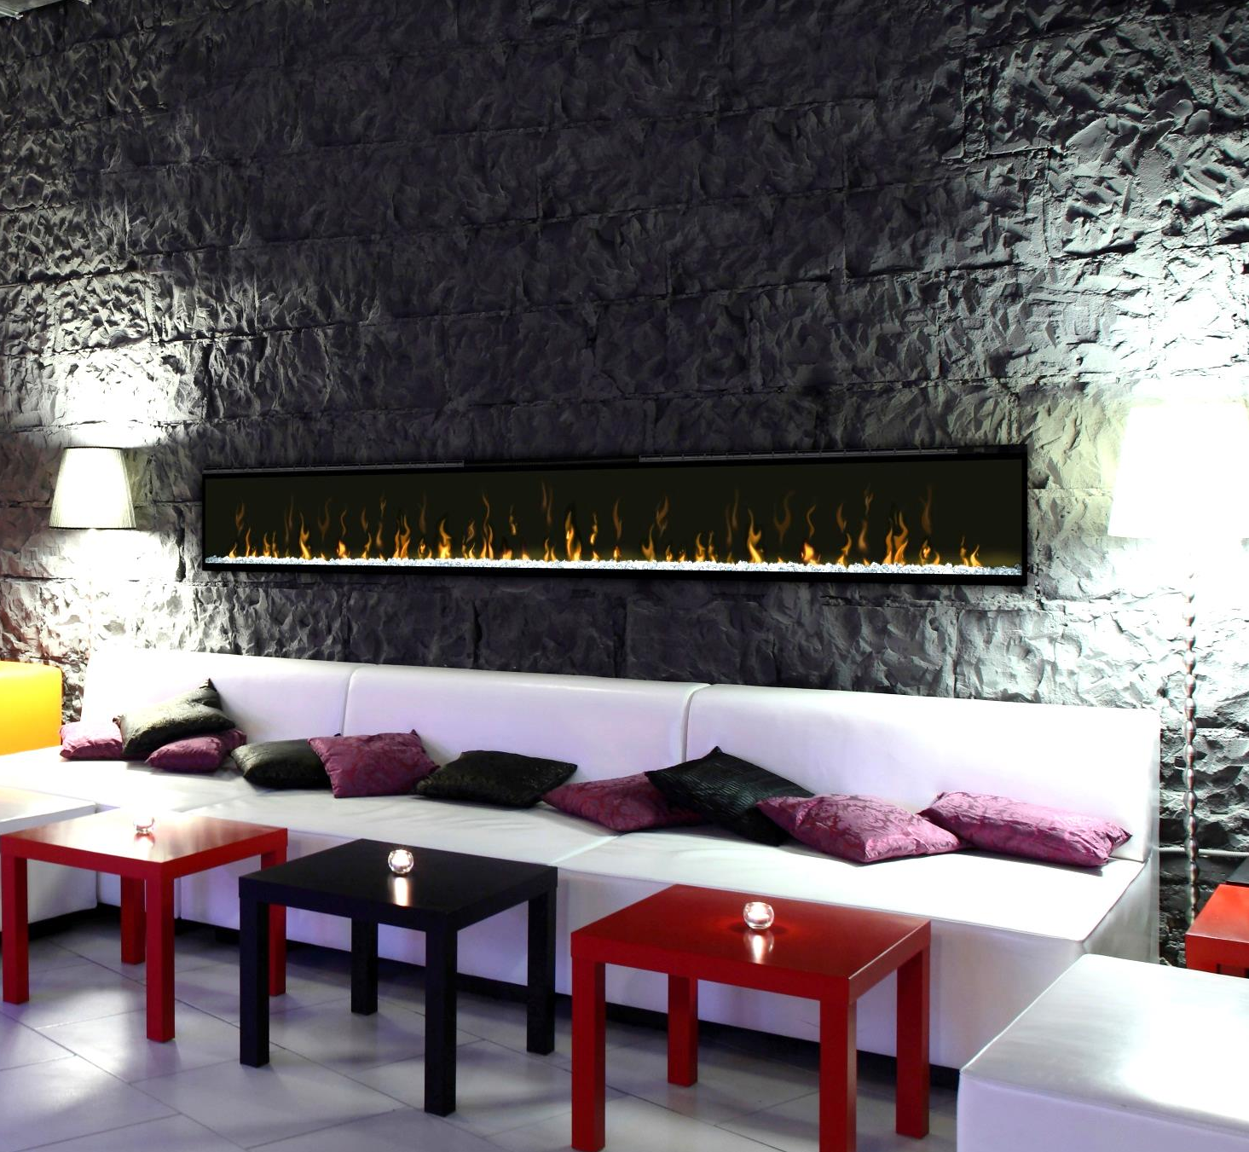

Color Effects
Full spectrum of sparkling colors
Choose from one of the eight preset themes that allow the user to customize the color to suit their taste and décor
Custom mode cycles through all colors – custom color can also be selected in this mode

Slide 7
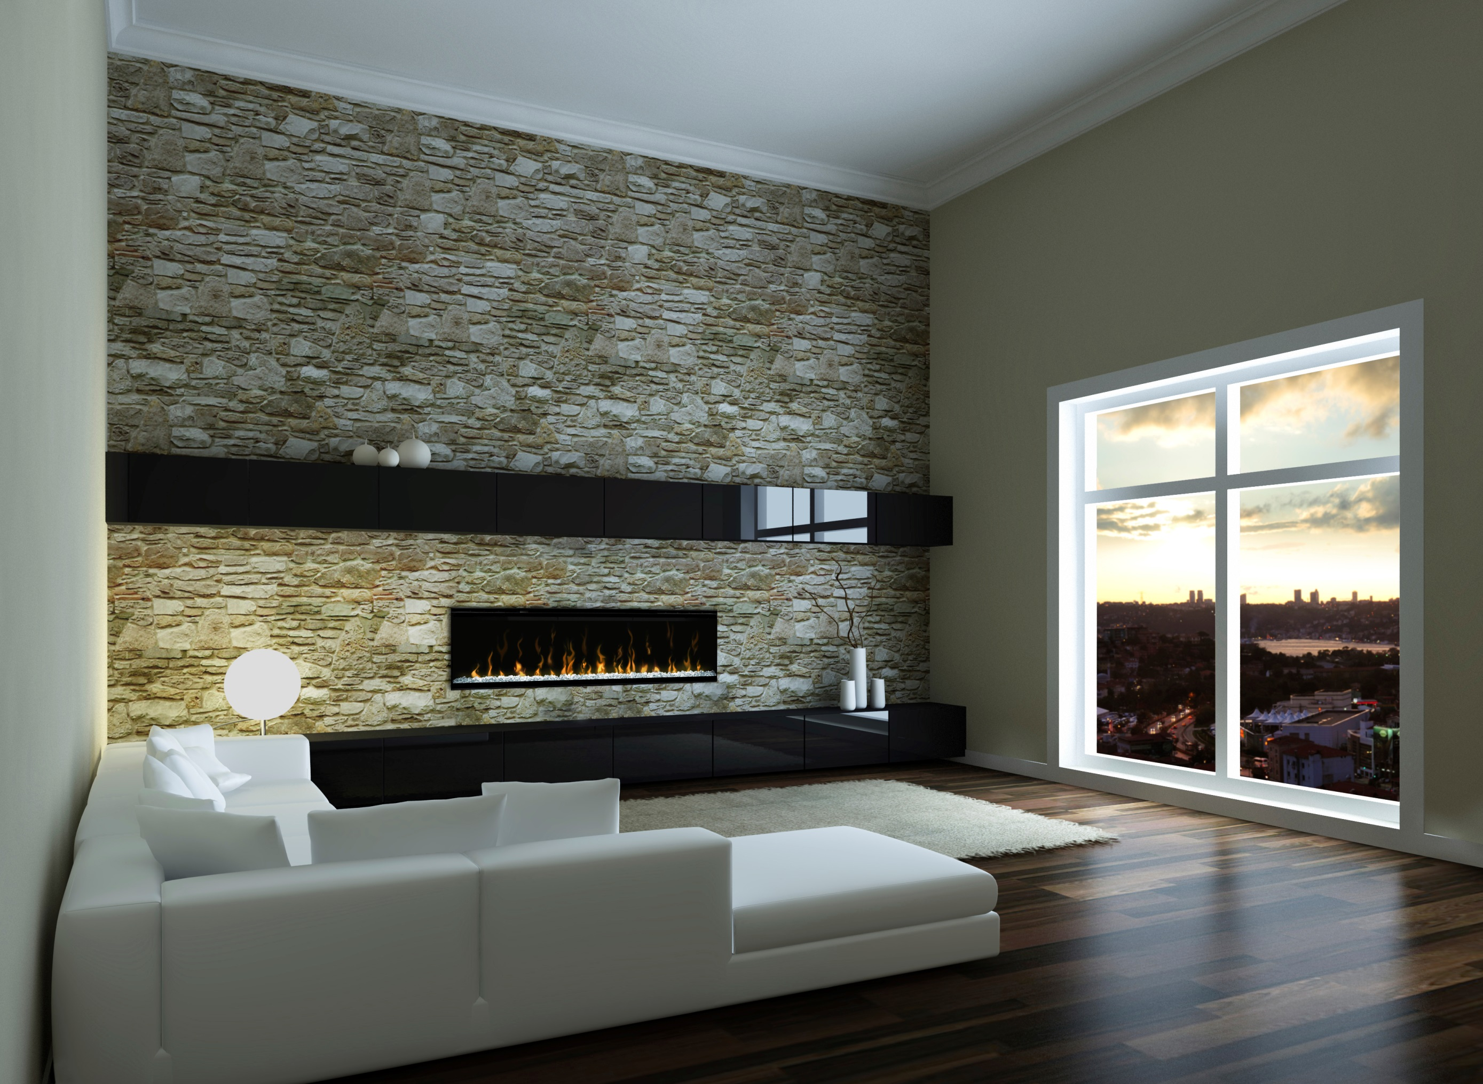
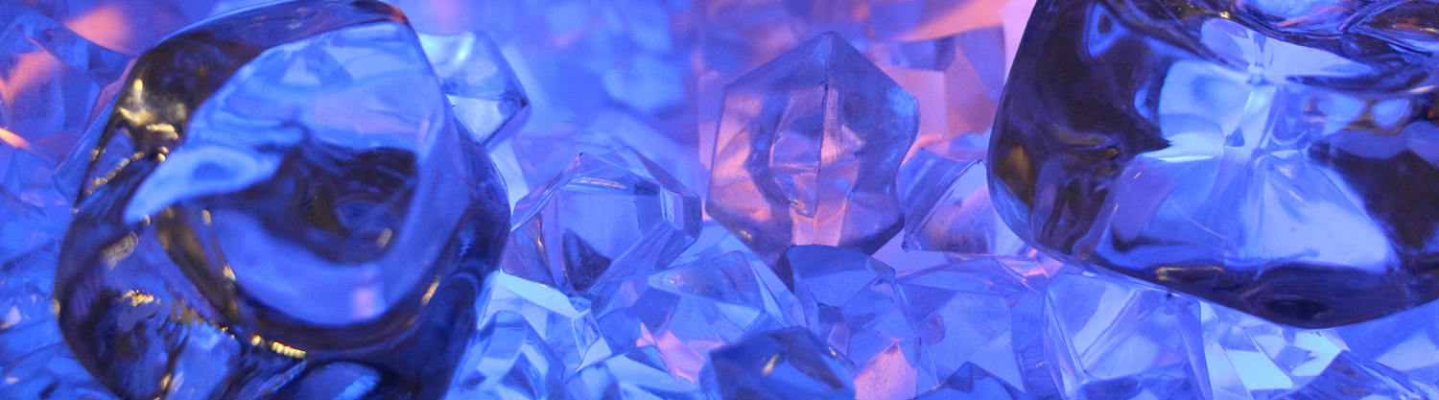
Diamond-like Acrylic Media
Diamond-like acrylic ice media is lit by brilliant LED’s
Sparkle effect allows random points of light to shine through, and enhance, the look of the media

Slide 8
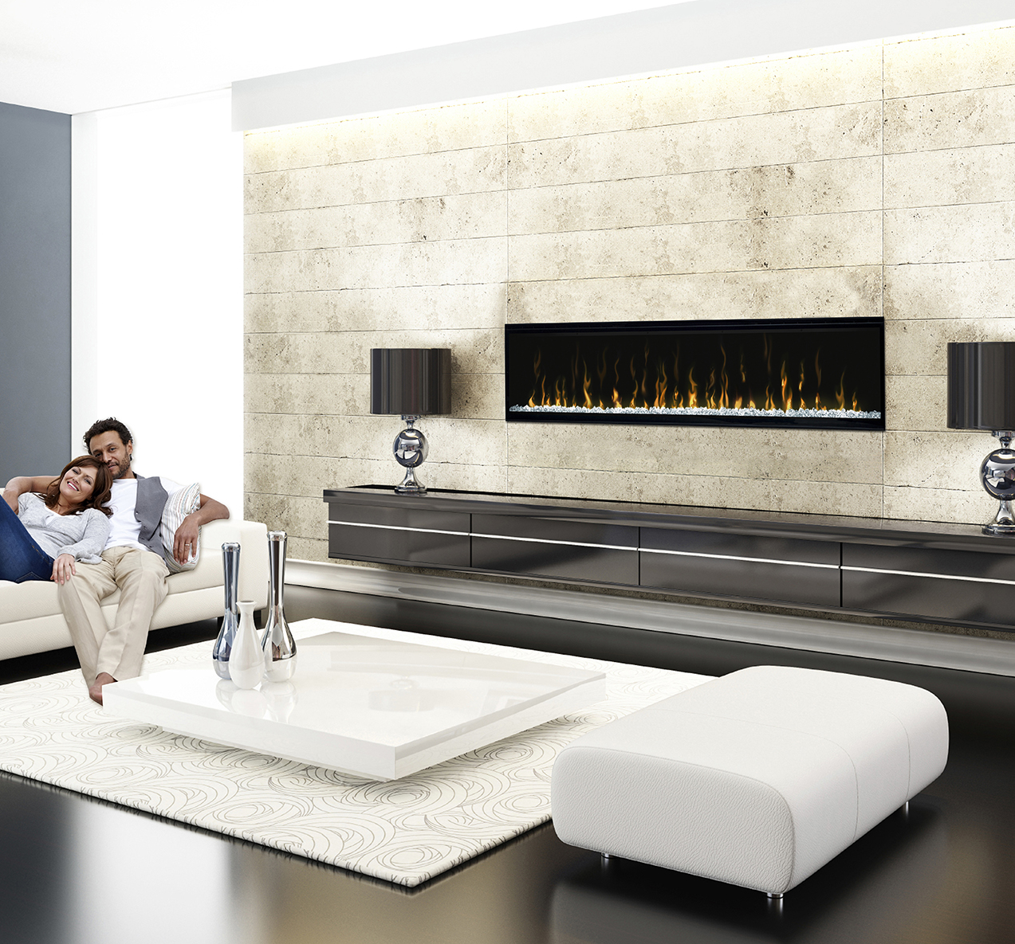
Comfort$averTM Heating System
On-demand, supplemental heating warms up to 1,000 sq. ft.
Automatically adjusts fan speed and wattage to the right amount of heat for any room
11% more energy efficient than conventional heaters including quartz radiant
Safe, quiet ceramic heating elements

Slide 9

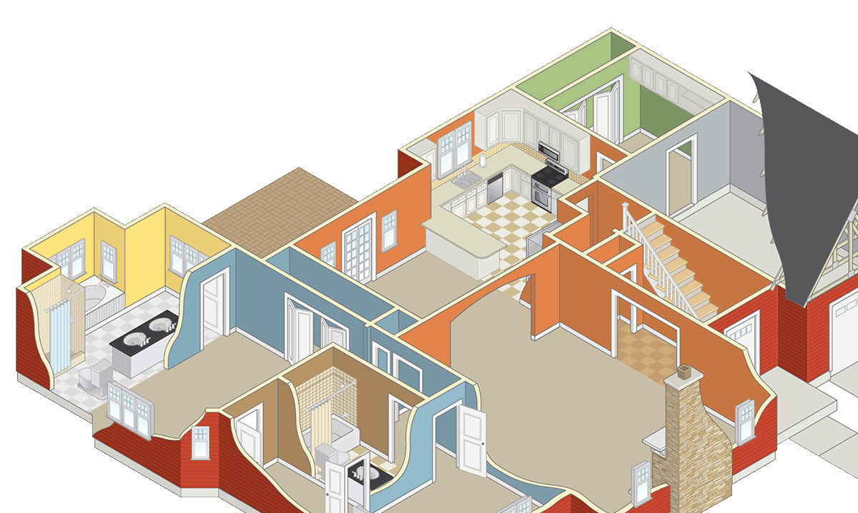
Comfort$averTM Heating System
Heater deactivation is ideal for commercial installations or where heat is not needed
Eco Mode automatically reduces energy use
Heat Boost delivers timed maximum heat output for up to 20 minutes

Slide 10
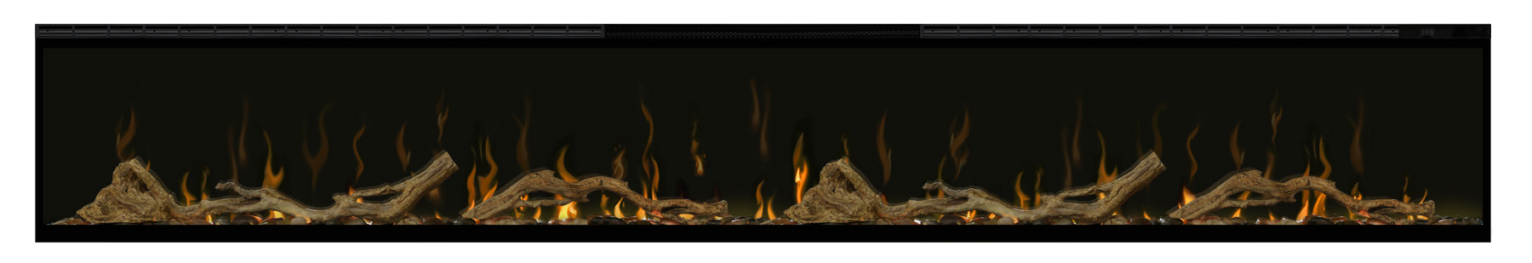
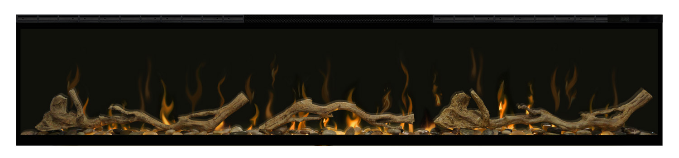
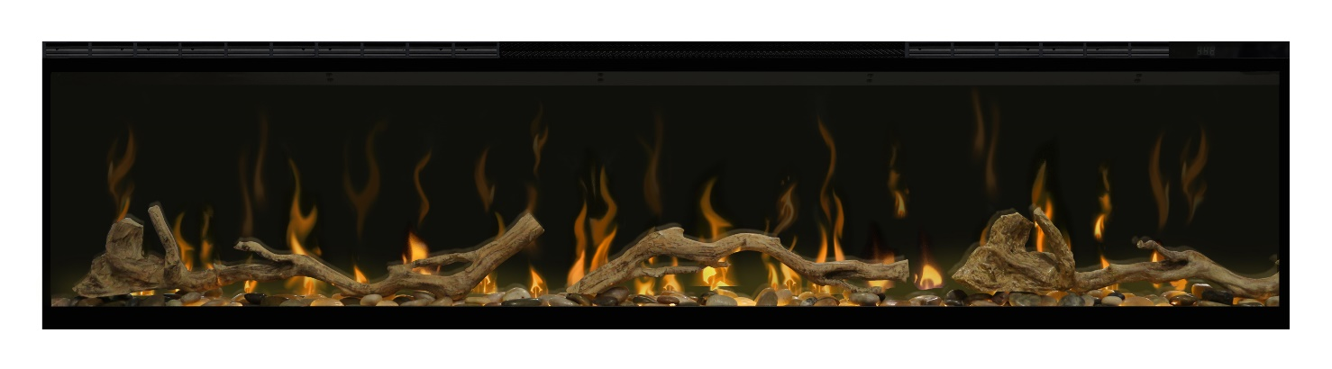
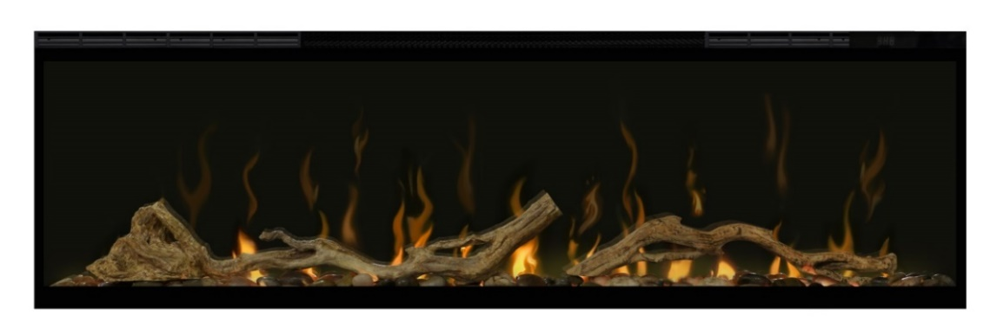
Linear Electric Fireplaces
XLF100
XLF74
Driftwood and River Rock Accessory Packages provide a charming, natural look
XLF60
Compliments traditional décor
Logs are molded from authentic driftwood; tumbled river rock provides the right amount of sparkle
XLF50

Slide 11
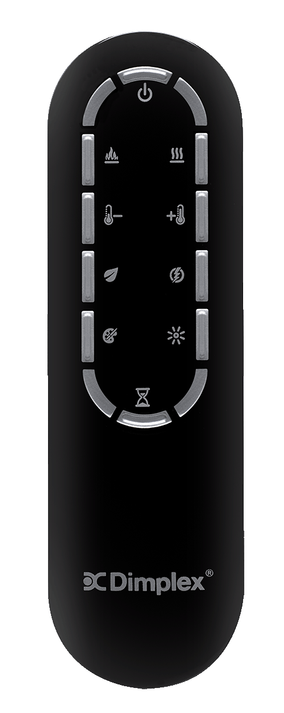
Multi-function Remote Control
Standby
Turns unit on at all previous settings
Turns all unit functions off
Heat On/Off
Turns on the Comfort$averTM Heating System
Turns heat off
Flame On/Off
Turns the flame effect on
Turns flame off
Temperature Up
Increases the thermostat set temperature
Temperature Down
Lowers the thermostat set temperature
Heat Boost
Turns on full-heat for 5 minutes
10 minutes
15 minutes
20 minutes
Turns boost off
Eco Mode
Automatically lowers heat output to achieve maximum energy savings
Brightness/Flicker
Full brightness
Low brightness
Flickering full brightness
Flickering low brightness
Color Themes
White media
White media / red flame base
White media / blue flame base
Red
Blue
Custom – cycles all colors, freeze/unfreeze any color
Kaleidoscope - base and media change color separately
Flame / no media (Midnight Mode)
Sleep Timer
Turns timer on for 30 minutes
Adjust duration up to 8 hours
Cancel timer

